Slide 1
Lecture 17:
4.6. The Development of Underdevelopment
Brad DeLong
Department of Economics & Blum Center, U.C. Berkeley; & WCEG
last revised: Mo 2020-03-26
for presentation: Th 2020-03-31
Original course by Melissa Dell (Harvard Econ 1342), revised by Brad DeLong
<https://github.com/braddelong/public-files/blob/master/econ-135-lecture-17.pptx>
<https://www.icloud.com/keynote/0lWeNgJnwEjyoHm3Gf81hWJXw>

Slide 2
How We Will Run This Course Going Forward…
17. Tu Mar 31: 4.6. The Development of Underdevelopment
Read Before: W. Arthur Lewis (1978): Evolution of the International Economic Order <https://github.com/braddelong/public-files/blob/master/lewis-evolution-a.pdf> <https://github.com/braddelong/public-files/blob/master/lewis-evolution-b.pdf>
Slides: <https://github.com/braddelong/public-files/blob/master/econ-135-lecture-17.pptx>
18. Th Apr 2: Touring the Continents: 5.1. Western Europe, North America, and South America
Read Before: Joel Mokyr (1990): Lever of Riches, chapter 10 Britain and Europe <https://delong.typepad.com/files/mokyr-lever-europe.pdf>
Read Before: John Coatsworth (2008).: Inequality, Institutions and Economic Growth in Latin America <https://delong.typepad.com/files/coatsworth-institutions.pdf>
Slides: <https://github.com/braddelong/public-files/blob/master/econ-135-lecture-18.pptx>
19. Tu Apr 7: 5.2. Behind the Iron Curtain, and East Asian Miracles
Read Before: Peter Evans (1995): Embedded Autonomy: States and Industrial Transformation, chapter 1 <https://delong.typepad.com/files/evans-embedded-i.pdf>
Read Before: Yingyi Qian (2001): How Reform Worked in China <https://delong.typepad.com/files/qian-reform.pdf>
Read Before: Richard Ericson (1991): The Classical Soviet-Type Economy: Nature of the System and Implications for Reform <https://delong.typepad.com/files/ericson-soviet.pdf>
Slides: <https://github.com/braddelong/public-files/blob/master/econ-135-lecture-19.pptx>
20. Th Apr 9: 5.3. Asia and Africa
Read Before: Nathan Nunn (2008): The Long Term Effects of Africa's Slave Trades <https://dash.harvard.edu/bitstream/handle/1/3710252/Nunn_Long-TermEffects.pdf>
Read After: Sevkut Pamuk (2014): Institutional Change and Economic Development in the Middle East, 700-1800 <https://delong.typepad.com/files/pamuk.pdf>
Slides: <https://github.com/braddelong/public-files/blob/master/econ-135-lecture-20.pptx>

Slide 3
Roadmap for the Next Two Weeks…
17. Tu Mar 31: 4.6. The Development of Underdevelopment
Read After: W. Arthur Lewis (1978): Evolution of the International Economic Order <https://delong.typepad.com/sdj/2008/04/w-arthur-lewis.html>
Slides: <https://github.com/braddelong/public-files/blob/master/econ-135-lecture-17.pptx>
18. Th Apr 2: Touring the Continents: 5.1. Western Europe, North America, and South America
Read Before: Joel Mokyr (1990): Lever of Riches, chapter 10 Britain and Europe <https://delong.typepad.com/files/mokyr-lever-europe.pdf>
Read Before: John Coatsworth (2008).: Inequality, Institutions and Economic Growth in Latin America <https://delong.typepad.com/files/coatsworth-institutions.pdf>
Slides: <https://github.com/braddelong/public-files/blob/master/econ-135-lecture-18.pptx>
19. Tu Apr 7: 5.2. Behind the Iron Curtain, and East Asian Miracles
Read Before: Peter Evans (1995): Embedded Autonomy: States and Industrial Transformation, chapter 1 <https://delong.typepad.com/files/evans-embedded-i.pdf>
Read Before: Yingyi Qian (2001): How Reform Worked in China <https://delong.typepad.com/files/qian-reform.pdf>
Read Before: Richard Ericson (1991): The Classical Soviet-Type Economy: Nature of the System and Implications for Reform <https://delong.typepad.com/files/ericson-soviet.pdf>
Slides: <https://github.com/braddelong/public-files/blob/master/econ-135-lecture-19.pptx>
20. Th Apr 9: 5.3. Asia and Africa
Read Before: Nathan Nunn (2008): The Long Term Effects of Africa's Slave Trades <https://dash.harvard.edu/bitstream/handle/1/3710252/Nunn_Long-TermEffects.pdf>
Read After: Sevkut Pamuk (2014): Institutional Change and Economic Development in the Middle East, 700-1800 <https://delong.typepad.com/files/pamuk.pdf>
Slides: <https://github.com/braddelong/public-files/blob/master/econ-135-lecture-20.pptx>

Slide 4
Roadmap Following: 6. Policy Issues…
6. Policy Issues
T Apr 14: 6.1. "Deep Roots" vs. Path Dependence
Read Before: Nathan Nunn (2012): Culture and the Historical Process <https://delong.typepad.com/files/nunn-culture.pdf>
Read Before: Melissa Dell (2015): Path Dependence in Development: Evidence from the Mexican Revolution <https://scholar.harvard.edu/files/dell/files/revolutiondraft.pdf>
Th Apr 16: 6.2. Growth and Fluctuations; Trade and Development, Foreign Aid
Read After: Barry Eichengreen (2015): Hall of Mirrors: The Great Depression, The Great Recession, and the Uses-and Misuses-of History, selections <https://delong.typepad.com/files/eichengreen-mirrors.pdf>
Read After: David Atkin (2014): Endogenous Skill Acquisition and Export Manufacturing in Mexico <https://delong.typepad.com/files/atkin-skill.pdf>
T Apr 21: 6.3. Populism, Plutocracy, Kleptocracy, & Neo-Fascism
Read Before: Ernest Gellner (1973): Nations & Nationalism, selections <https://delong.typepad.com/files/gellner- nations.pdf>
Read Before: Barry Eichengreen (2018): The Populist Temptation Economic Grievance & Political Reaction in the Modern Era, selections <https://delong.typepad.com/files/eichengeeen-populist.pdf >
Th Apr 23: 6.4. Global Warming
Read After: Melissa Dell et al. (2012): Temperature Shocks & Economic Growth: Evidence from the Last Half Century <https://scholar.harvard.edu/files/dell/files/aej_temperature.pdf>
Read After: Melissa Dell et al. (2014). What Do We Learn from the Weather? The New Climate-Economy Literature, selections <https://economics.mit.edu/files/9138>
T Apr 28: 6.5. The Pace and Meaning of Economic Growth
Read Before: William Nordhaus: Do Real-Output and Real-Wage Measures Capture Reality? <https://www.nber.org/chapters/c6064.pdf>
Read Before: John Maynard Keynes: Economic Possibilities for Our Grandchildren<<https://delong.typepad.com/files/keynes-persuasion.pdf>
Read Before: Edward Bellamy (1887): Looking Backward 2000-1887, selections <https://delong.typepad.com/files/bellamy-backward.pdf>

Slide 5
Roadmap Following: 7. Conclusion…
7. Conclusion
Th Apr 30: 7. Conclusion: The Future?
Read After: Robert Allen (2011): Global Economic History: A Very Short Introduction, selections <https://delong.typepad.com/files/allen-geh.pdf >
W May 13 11:30-14:30: FINAL PAPER/PROJECT DUE

Slide 6
Coronavirus!
There were 2027 reported deaths in the U.S. from the novel coronavirus as of late on Mar 28—if our reporting systems have not yet broken down.
With a 1% death rate, and with 3 weeks between infection and death, that means that as of Mar 7 there were 202700 coronavirus cases in the United States.
Up through Mar 28 deaths have been doubling every three days, suggesting that before Mar 7 true cases were also doubling every three days:
If that that pace has continued since, by Mar 31 we will have had 8 further doublings: 52 million cases, 1/6 of the population.
If the curve bent to doubling every four days, by Mar 31 we will have had 6 further doublings: 13 million cases, 1/25 of the population, with an additional 30 million cases expected by April 7
If the curve bent to doubling every six days, by Mar 31 we will have had 4 further doublings: 3.2 million cases, 1/100 of the population, with an additional 3.8 million cases expected by April 7
If the curve bent to doubling every eight days, by Mar 31 we will have had 3 further doublings: 1.6 million cases, 1/200 of the population, with an additional 1.5 million cases expected by April 7
If the curve bent to doubling every twelve days, by Mar 31 we will have had 2 further doublings: 800,000 cases, 1/400 of the population, with an additional 600,000 cases expected by April 7
If the curve bent to doubling every twenty-four days, by Mar 31 we will have had 1 further doubling: 400,000 cases, 1/800 of the population, with an additional 200,000 cases expected by April 7
As of the morning of Mar 29, the U.S. had 125,000 cases
As of the evening of Mar 28, the U.S. had tested 650,000 people, with a 19% positive rate. Applying that to our six scenarios, in each scenario those we have tested are, respectively, 1, 5, 10, 20, 40, and 80 times more likely to have the disease than the average probability of having the disease.
Question: What is wrong with this analysis?

Slide 7


MOAR Coronavirus!
As of March 16: Things are not moving in the right direction:
What is the R0?
How can the R0 be changed?
How will the R0 change?
What is the asymptote share of the population?
What is the mortality rate?

Slide 8


MOAR Coronavirus!
As of March 10: Things are not moving in the right direction:
What is the R0?
How can the R0 be changed?
How will the R0 change?
What is the asymptote share of the population?
What is the mortality rate?

Slide 9
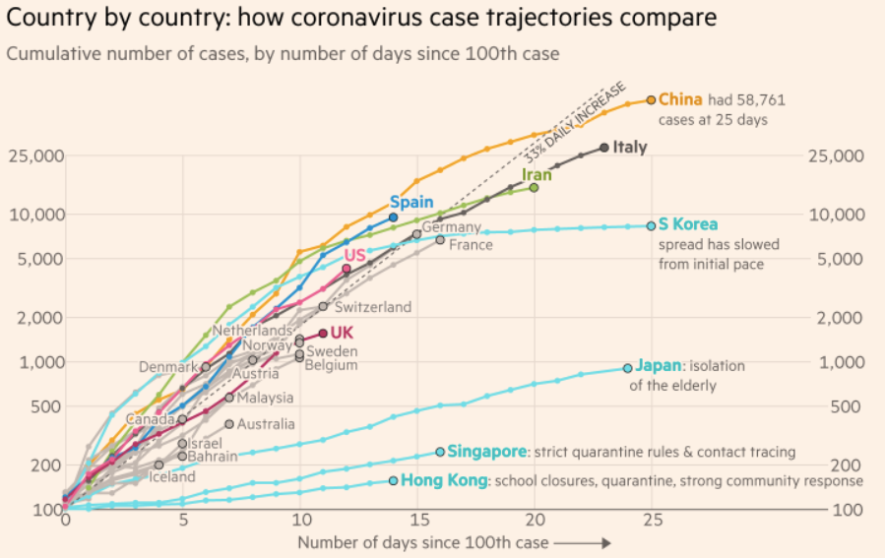
MOAR Coronavirus!
What I am watching:
Max Roser & Hannah Ritchie: Coronavirus Disease (COVID-19)_ <https://ourworldindata.org/coronavirus>…
Worldometer: Coronavirus Update (Live) <https://www.worldometers.info/coronavirus/>: ‘125,599 Cases and 4,605 Deaths from COVID-19 Virus Outbreak…
FT Coronavirus Tracker <https://www.ft.com/content/a26fbf7e-48f8-11ea-aeb3-955839e06441>
<https://www.nytimes.com/interactive/2020/us/coronavirus-us-cases.html>

Slide 10

MOAR Coronavirus!
It’s a Thing for Geezers!
Mortality for the Youngs very low…
It’s the flu for them…

Slide 11
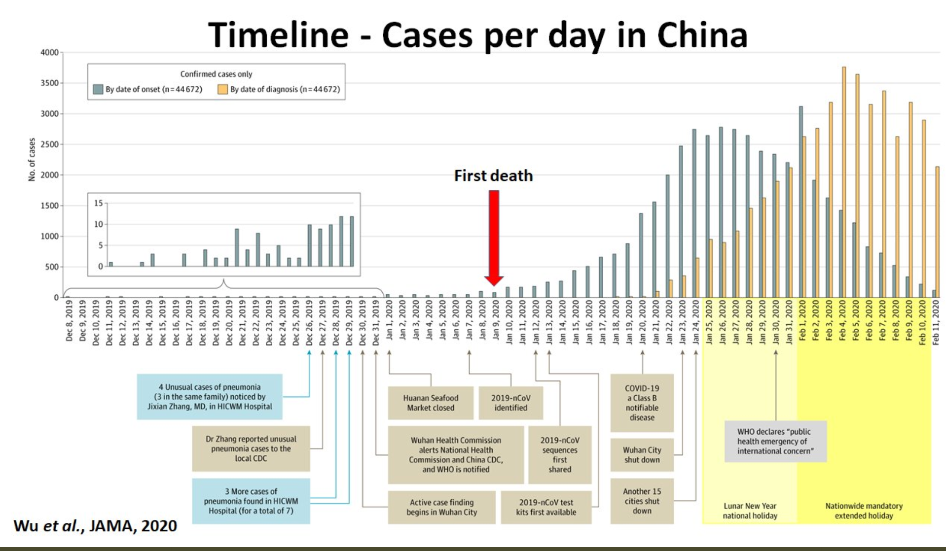
MOAR Coronavirus! II
China Beat It!
Shut down Wuhan when 200 cases per day
That seems to have been a good decision

Slide 12

MOAR Coronavirus! III
When Is It Appropriate to Move on This?
Immediate social distancing…
Self-isolate if you have a cough and a fever…
Hope that warmer temperatures will do to this what they did to SARS…
Otherwise, when do you want to start spreading out transmission. It seems that early is as good as later…

Slide 13
Coronavirus!
With 31 deaths in the U.S. as of March 11, a 1% death rate, and up to 4 weeks between infection and death, that means that as of Feb 12 there were 3100 coronavirus cases in the United States.
With 73 deaths in the U.S. as of Mar 16, a 1% death rate, and up to 4 weeks between infection and death, that means that as of Feb 17 there were 7300 coronavirus cases in the United States
If it is doubling every seven days, then now about 116,000 people have and in the next week about 116,000 more people in the U.S. will catch coronavirus—which means 1/2700, currently 3000 of the 7.6 million inhabitants of San Francisco Bay. Touch a hard surface that any of those 3000 has touched in the last 48 hours, and the virus has a chance to jump to you…
These numbers could be five times too big. These numbers are probably not five times too small unless the thing is a lot less deadly, and there are a lot of asymptomatic cases…
What is wrong with this analysis?

Slide 14
Catch Our Breath…
Ask a couple of questions?
Make a couple of comments?
Any more readings to recommend?

Slide 15
Notes

Slide 16
Big Ideas: Lecture 16: Inequality and Plutocracy
Takeaways from last lecture:
Give me five…

Slide 17
Discussion
The Development of Underdevelopment:
What strikes you as important here?

Slide 18

The Watershed: 1870 as the Inflection Point
As of 1870, had the Industrial Revolution raised the standard of living or lightened the toil of the working class in England, the country at its center?
No.
Why not? Malthusian forces—population explosion & thus smaller farm sizes.
Pace of technological and organizational change not fast enough to raise incomes high enough to force the demographic transition.
Hence importance of 1870: our h goes from 0.44%/yr to 2.06%/year, globally, and sticks there since
(Until now?)
Principal cause of the speed-up? The modern corporation and its industrial research labs that made routine the process of developing and then implementing new productive ideas.
(Was this baked in the cake by the Industrial Revolution? Or could this have been bobbled?)
Assisting: globalization:
Globalization of goods through trade using railroads and iron-hulled steamships
Globalization of people through migration using railroads and iron-hulled steamships
Globalization of communications using the telegraph
Yet: DIVERGENCE, BIGTIME
4:00
Notes:
The Watershed: 1870 as the Inflection Point
As of 1870, had the British Industrial Revolution raised the standard of living or lightened the toil of the working class in England, the country at its center? No. Why not? Because of Malthusian forces—a population explosion & thus smaller farm sizes would result from any improvement in human technological knowledge about the control of nature and the organization of humans. The smaller farm sizes produced by larger populations would reduce productivity. Thus while human technological knowledge capital-H would increase and could increase significantly, human labor efficiency capital-E would not. And the pace of technological and organizational change not fast. Not fast enough to raise incomes high enough to force the demographic transition, and break the mold of this Malthusian system.
From this comes the permanent world-historical importance of 1870: Around the year 1870—in the generation between 1860 and 1880—our worldwide lower case-h proportional rate of growth in the value of the stock of useful human technological knowledge about the control of nature and the organization of humans.goes from 0.44%/yr to 2.06%/year. And there it sticks—until, possibly, this rate of growth drops off, starting now. (But that is the subject for another time.)
The principal cause of this speed-up? The coming of the modern industrial research lab and the growth of the STEM labor force that made the process of creating, developing, and then providing proof-of-concept of new productive technological ideas a routine and routinized and rationaalized one. Plus the coming of the modern corporation that made the process of deploying new technological ideas on a global scale a routine and routinized and rationalized one.
Was the growth of the STEM labor force, the development of the industrial research lab, and the coming of the modern corporation inevitable—baked in the cake—as a result of what went down during the 1770-1870 British Industrial Revolution era? Or might the path to this circa-1870 economic-engineering-technological breakthrough have been missed? This is a deep question that we do not have good answers to. I tend to say that it was not baked in the cake, at least not by anything that happened in the first two-thirds 1770-1840 of the British Industrial Revolution century. Why do I think this? Because arguments that it was baked in the cake tend, I think, to lead us to have expected another couple or more of speed-ups in lower case-h since. And we have not had such.
But assisting the STEM-lab-corporation trio in discontinuously and substantially boosting lower case-h was globalization:
* Globalization of goods through trade ,using railroads and iron-hulled steamships
* Globalization of people through migration, using railroads and iron-hulled steamships
* Globalization of communications, using the telegraph
Yet, somehow, at least the first century of the post-1870 Modern Economic Growth era has also seen DIVERGENCE, BIGTIME. While economic and political-economic processes have seen the global north develop massively, they have also seen the emergence of enormous income and productivity gaps between the global north and the global south. While the global north has been developed, the global south has been underdeveloped—has grasp of a lot smaller a fraction of the human technological cornucopia H than it had hold of in 1870, or, indeed, at any time earlier.

Slide 19
The Economic El Dorado of 1870-1914
Or so John Maynard Keynes called it in his The Economic Consequences of the Peace, looking back from 1919:
In heavy industries the global north in 1914 was remarkably modern
In 1913 Britain burned 194 million tons of coal. Total coal-equivalent energy consumption of Britain today less than 3x 1913
Average U.S. passenger RR mileage in 1913: 350/person. Average U.S. airline miles today: 3000/person
In other ways, even the global north poor and premodern:
Agriculture largely unmechanized
More than half of Americans still working on the farm
Only Britain and Belgium with less than half of the labor force in agriculture
Nitrogen artificial fertilizers just coming on line
People still worked like dogs in the South Pacific to mine the products of avian defecation off of islands offshore of Chile—and then ship the guano back to Europe as fertilizer
Social and political dominance of landlord-aristocrats.
3:30
Notes:
The jump in lower case-h from 0.44%/year to 2.06%/year around 1870 meant that the next half-century—the years before World War I began in 1914—were, as John Maynard Keynes, looking back from 1919, called it in his The Economic Consequences of the Peace, an economic El Dorado: a previously unseen and unimagined epoch of expansion in global wealth and prosperity, visible nearly everywhere all over the globe.
And as a result, in same ways that world economy as it stood in 1914 on the eve of World War I was remarkably modern. This was true in heavy industries, especially. In 1913 Britain burned 194 million tons of coal. Total coal-equivalent energy consumption of Britain less is less than three times as large. Average U.S. passenger railroad mileage in 1913 was 350 miles/person. The average American thus spent ten hours on a train getting someplace at a distance and at a speed beyond the wildest imaginings of previous centuries, save for miracle tales like the one in which an angel carries the Prophet Habbukuk by the hair from Jerusalem to Babylon to feed the Prophet Daniel a bowl of stew he had just cooked. Today average U.S. airline miles per year are 3000/person. Today we travel ten times as fast and ten times as far on average, but the quantum gap is between 1800 and 1914, not beween 1914 and today.
In other ways, however, even the global north was desperately poor and premodern, even in the most advanced parts. Agriculture, even in North America, was still largely unmechanized: more than half of Americans still working on the farm. Only Britain and Belgium had less than half of the labor force in agriculture, and that was not because their food was grown via mechanized agriculture, but because their manufacturing exports allowed them to have the farmers who grew by hand the crops that fed them be located in other parts of the world with more abundant and better land.
Remember, in the years before World War I, nitrogen artificial fertilizers were just coming on line. People still worked like dogs in the South Pacific to mine the products of avian defecation off of islands offshore of Chile and Peru—and then ship the guano back to Europe as fertilizer. “Guano King” was an occupation and description of more than one plutocrat in those days.
And 1914 still saw, throughout all of the globe save the recent-European-settlement English-speaking lands of Australia, New Zealand, Canada, and the United States, the remarkably thorough political dominance of landlord-aristocrats:
* people who feared being creatively destroyed by economic, political, and sociological change;
* people who had lost or who were rapidly losing any claim to performing a valuable social role;
* people who were then remarkably eager to stoke the flames of nationalism and roll the dice of war, in order to “busy giddy minds with foreign quarrels” and so distract the thoughts of those they wanted to have remain their underlings from ideas like “socialism”, “progressive taxation”, and “expanded government provision of commodities”.

Slide 20
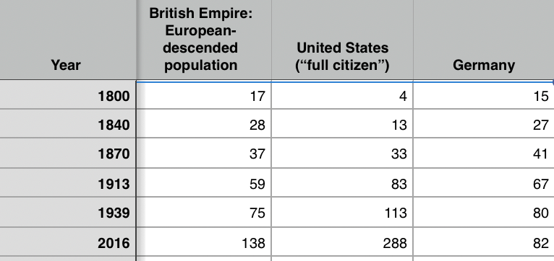
Migration 1870-1914
100 million people left their continents of origin between 1870-1913—70 million of them permanently:
9 days from Liverpool to New York: it had taken a month in 1800
1.5 month’s wages for an unskilled European worker—to double your pay, and your children’s pay
50 million from Europe, 50 million from Asia
Migration and global inequality
The development of underdevelopment in the global south can be understood only as a consequence of these waves of migration
Migration and exceptional America
Only America’s welcoming of migration gave it the demographic heft to be the world’s 20th century superpower
5:30
Notes:
One of the key factors that made the twentieth century what it was was the course that migration took over 1870-1914.
During the half-century before World War I, 100 million people left their continents of origin—70 million of them permanently.
They did so because of the iron-hulled screw-propellered ocean-going steamship. After 1870 it took 9 days from Liverpool to New York: it had taken a month in 1800. After 1870 a steerage-class ticket for such a transatlantic voyage cost only 1.5 of a month’s wages for an unskilled European worker. Pay 1.5 of a month’s wages—or have a relative already in the New World pay 3/4 of a month’s of their wages—for the journey, and you double your pay, and your children’s pay.
Wages were lower in China and India, and so costs were proportionately higher. But the wage gaps were as large: Chinese for San Francisco is still “Gold Mountain”.
And so 50 million from Europe and 50 million from Asia changed continents.
This was an absolute bonanza for those who made the voyage. This was a relief for those back at home who found resources less crowded and scarce.
But this was also a principal source of global inequality—a reason why the global south found itself as a whole leveled down to the Chinese and Indian standard, for China and India were then in the down, poverty-stricken phase of the Malthusian cycle. The development of underdevelopment in the global south can be understood only as a consequence of these waves of migration.
And this great migration wave was a big reason that the United States of America became truly exceptional throughout the twentieth century. Only America’s welcoming of migration—and Germany’s lack of the land and thus the living standards to absorb migrants from eastern and southern Europe, and the British Empire’s lack of the will and desire to absorb eastern and southern European migrants—gave America the demographic heft it needed for it to become the world’s dominant 20th century hyperpower as it became the one to fill the niche of Saxon-descended superpower.
Back in the days of the decline of the Roman Empire there was a tribe called the “Saxons”. Some of them crossed the North Sea to Britain. Others stayed in Germany. In England today there are three counties named after the Saxons—Essex, Sussex, and Middlesex—plus there is a Earl of Wessex; in Germany there are Niedersachsen, Sachsen, and Sachsen-Anhalt. In the United States there are five Essex, four Middlesex, and three Sussex counties; and I have not looked in Canada, Australia, or New Zealand. That makes eighteen counties plus an earldom named for the original tribe in the lands of the Anglo-Saxon and the Saxon-Saxons.
Of these peoples’ three countries back in 1800, the British Empire had 17 million European descended subjects—plus Indians, descendants of Africans, and others who the Empire was not interested in educating and so would not make a source of strength rather than a subjugated people whom it cost resources to hold down so they could be exploited. The kingdoms in the lands that would become modern Germany had 15 million. The United States had 4 million—plus 1.5 million African-Americans and 500,000 Amerindians whom, like the British Empire, they were not interested in educating and so would not make a source of strength rather than a subjugated people whom it cost resources to hold down so they could be exploited. Back in 1800, in the race for what nation would become the Saxon-descended 20th century superpower, Britain was ahead of Germany not so much by virtue of its population but of its industry, while the U.S. was far behind.
By 1840 the Saxon language group-speaking populations were 28 million in the British Empire, 27 million in the German states, and 13 million in America—the edge still to Britain, again by its level of industrialization, although the U.S. was catching up fast.
By 1870 the full-citizen populations were: the about-to-be-formed German Empire with 41, the British Empire with 37, and America with 33 million, with the U.S. catching up fast because of both natural increase and waves of immigration from the British Empire in the wake of the Irish potato famine and from Germany as well. By 1913 America had a small edge in industrialization over both Britain and Germany, which were about equal; and America had taken the full-citizen population edge: 83 full-citizens as opposed to 67 in Germany and 59 million in Britain—a 25% edge to America. By 1939 America would have a 42% larger full-citizen population than Germany, and a 50% population edge over the British Empire.
Without the U.S.’s welcoming to eastern and southern European migrants, that would not have happened. And the 20th century would then have been much less of an American century.

Slide 21
Migration from Asia
The “development of underdevelopment” in the global south:
50 million left from China and India:
Peru had a President surnamed Fujimori.
The author V.S. Naipaul was born in the Caribbean.
The redwood forests of California contain shrines to the boddhisatva Guan-Yin.
A uniquely rapid redistribution of humanity around the globe.
However, migration from China to California and other temperate-climate destinations stopped:
Plutocrats like Leland Stanford favored immigration
Populists campaigned on: “Chinaman go home”
Populists won in this narrow respect: limiting Asian immigrants
2:01
Notes:
What role did migration—and the rest of globalization—play in the development of underdevelopment in the global south?
50 million left from China and India to places from South Asia and Africa to the Caribbean and the highlands of Peru. Peru in the late twentieth century could have a President surnamed Fujimori. The author V.S. Naipaul was born not in India but in the Caribbean. The redwood forests of northern California contain shrines to the boddhisatva Guan-Yin. Never before or since have we seen such a rapid proportional redistribution of humanity around the globe.
The redwood forests of northern California contain shrines to the boddhisatva Guan-Yin—although migration from China to European-settled California and to the rest of temperate-climate settler colonies and ex-colonies was quickly shut down. Plutocrats like Leland Stanford (the railroad baron and governor of California who founded and endowed Stanford University in memory of his son) favored immigration; the populists favored exclusion–and “Chinaman go home.”
In the temperate zone economies to which migrants from Europe went, the populists won out before World War I in one narrow aspect: with respect to making and keeping settler colonies “European”. Asian immigrants were largely kept out of what Arthur Lewis calls the “temperate countries of European settlement”–the United States, Canada, Argentina, Chile, Uruguay, Australia, and New Zealand. The flow of migrants out of China and India was directed elsewhere, to the tea plantations of Ceylon or the rubber plantations of Malaysia.

Slide 22
Migration from Asia Channeled to the Tropics
To the tea plantations of Ceylon, the rubber plantations of Malaysia, & c.:
This mattered
Migration out did not raise wages much in the migration-source economies of China and India
They were so large in population
Emigration was but a drop in the bucket
Did migration lower relative wages in tropical-zone recipient economies? Yes.
Plus it lowered relative wages in tropical-zone economies that never saw a migrant.
British capital, Brazilian-stock rubber plants, and labor imported from China went to Malaya
There it could and did put heavy downward pressure on the wages in Brazil of rubber tappers who did not know there was such a place as Malaya
1;15
Notes:
The flow of migrants out of China and India was directed elsewhere, to the tea plantations of Ceylon or the rubber plantations of Malaysia.
Migration out did not raise wages much in the migration-source economies of China and India. They were so large relatively in population that emigration was a drop in the bucket.
Did migration lower relative wages in tropical-zone recipient economies? Yes. Moreover, migration from China and India lowered relative wages in tropical-zone economies that never saw a migrant. British capital, Brazilian-stock rubber plants, and labor imported from China to Malaya could and did put heavy downward pressure on the wages in Brazil of people who did not know there was such a place as Malaya.

Slide 23
The Role of the British Empire
The British Empire made migration easy and plantation trade very profitable:
The comparative advantages of the regions that were to become the “periphery”
They were not so much given as made.
Where the British went they built:
a fort,
some docks, and
a botanical garden
The botanical garden to discover what valuable plants grown elsewhere might flourish here as well
The rubber plant to Malaysia
The tea shrub came to Ceylon
Plus the coffee bush came to Brazil
1:00
Notes:
Worth noting in all this is the role of the British Empire. The comparative advantages of the regions that were to become the periphery of the late nineteenth century global economy were not so much given as made. Where the British went they builT a fort, some docks, and a botanical garden—the botanical garden to discover what valuable plants grown elsewhere might flourish here as well. During the nineteenth century the rubber plant came to Malaysia, the tea shrub came to Ceylon, and the coffee bush came to Brazil. Rubber was not introduced into Malaysia, Indonesia, and Indochina until the last quarter of the nineteenth century. But by the end of World War I these three regions had become the principal sources of the world’s natural rubber supply.

Slide 24
The Down-Phase of the Malthusian Cycle in Asia and Its Consequences
China and India were at their poorest ever in 1870:
They had not escaped the Malthusian regime
Technology had advanced:
The population of China in 1870 three times 1000
Living standards somewhat lower
Migrants from China and India willing to move for what seemed to Europeans and others starvation wages
Checked the growth of wages in any of the areas–Malaysia, Indonesia, the Caribbean, or east Africa–open to the Asian migration stream
Thus commodities produced in countries open to Asian immigration were cheap
Competition from the Malaysian rubber plantations pushed down Brazil as well.
Thus living standards and wage rates became and remain relatively low throughout the global south
Hence no prosperous middle class
Hence no domestic demand in manufactures
Hence no chance of starting industrialization, building a community of engineering practice, and then taking the next step and so getting on to the escalator to modernity and prosperity
3:15
Notes:
India and China, through ill-luck and bad government, had not escaped the Malthusian regime. Technology had advanced: the population of China in the late nineteenth century was some three times what it had been at the start of the second millennium, and living standards were no (or not much) lower. But improvements in productive potential had been absorbed in rising populations, and not in rising living standards. So potential migrants from China and India were willing to move for what seemed to Europeans and others around the glober to be starvation wages.
Thus the large populations and low levels of material wealth and agricultural productivity in China and India checked the growth of wages in any of the areas–Malaysia, Indonesia, the Caribbean, or east Africa–open to the Asian migration stream. Workers could be cheaply imported and employed at wages not that far above the physical subsistence level. These workers would be very happy with their jobs: their opportunities and living standards in Malaysian or African plantations would be significantly above what they could expect if they returned to India or China. Low wage costs meant that commodities produced in countries open to Asian immigration were relatively cheap. And competition from the Malaysian rubber plantations checked growth and even pushed down wages of the Brazilian rubber tappers as well. The late nineteenth century saw living standards and wage rates become and remain relatively low (although higher than in China and India) throughout the regions that were to come to be called the third world.
And as wages in economies that were to become the global periphery were checked, the prospects for having a rich-enough middle class to provide demand for a strong domestic industrial sector ebbed rapidly.
As a result, the chain of causation went thus:
The openness of some places for tropical goods could be produced push down their prices in world markets. Low prices in the world markets meant low wages everywhere tropical goods were produced. Low wages meant no prosperous middle-class anywhere tropical goods were produced. No prosperous middle-class meant no mass domestic demand for manufactures. No domestic demand for manufactures meant no chance of starting industrialization. No chance of starting industrialization meant no building a community of engineering practice. No community of engineering practice meant no taking the next step and advancing in industrialization. No advancing in industrialization meant no walking onto the escalator to modernity and prosperity.
That, in a nutshell, is the story of the relative underdevelopment of the global south. It was not that globalization left the global south alone in the years before World War I. It was that globalization put it on a road that made its industrialization more difficult, even though the openness of world markets made it more prosperous in that pre-World war I half century seen rightly as a global El Dorado.

Slide 25
Big Ideas: Lecture 17: the Development of Underdevelopment
Takeaways from this class:

Slide 26
Catch Our Breath…
Ask a couple of questions?
Make a couple of comments?
Any more readings to recommend?

Slide 27

Notes, etc.…

